Slide 1
Charla Virtual de Trabajo Iniciando tu Carrera en UC Davis/UC Davis Health May 28, 2020
Notes:
Ellen

Slide 2
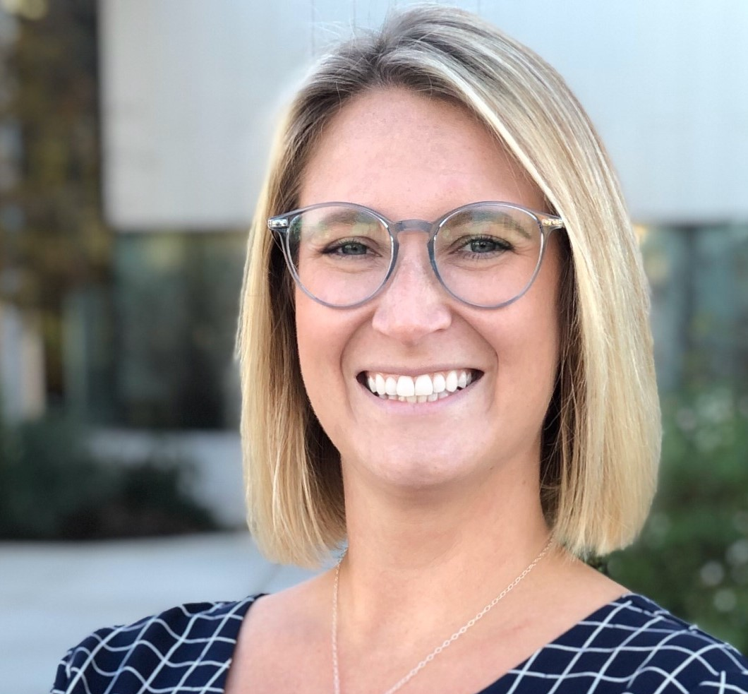
Introduccion
Ellen Jordan
Socio principal de Adquisicion de Talento,Reclutamiendo de Liderazgo y Servicios de Diversidad

Slide 3
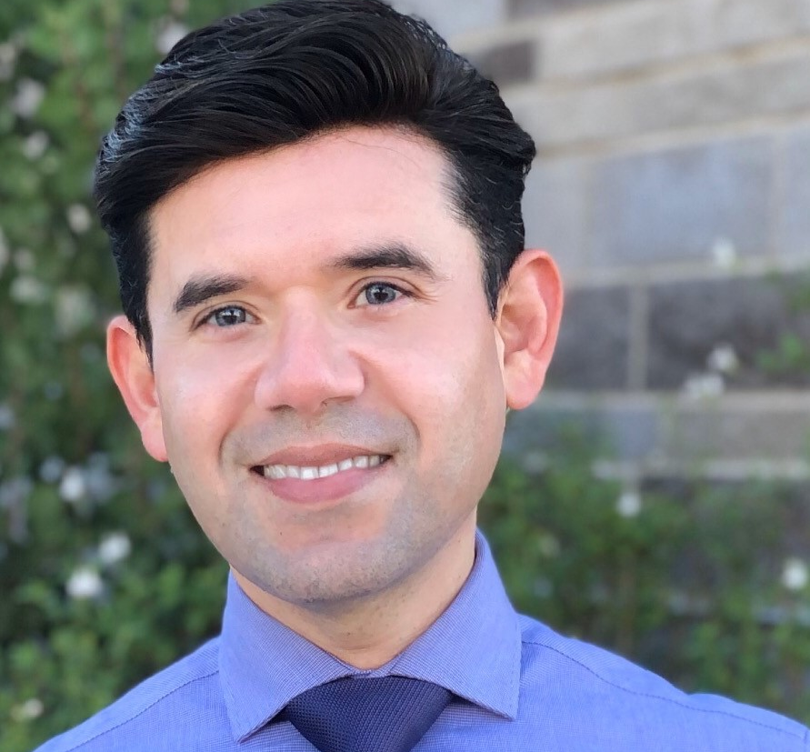
Introduccion
Mario Eguizabal, PHR
Socio principal de Adquisicion de Talento,Reclutamiendo de Liderazgo y Servicios de Diversidad
Notes:
Mario

Slide 4
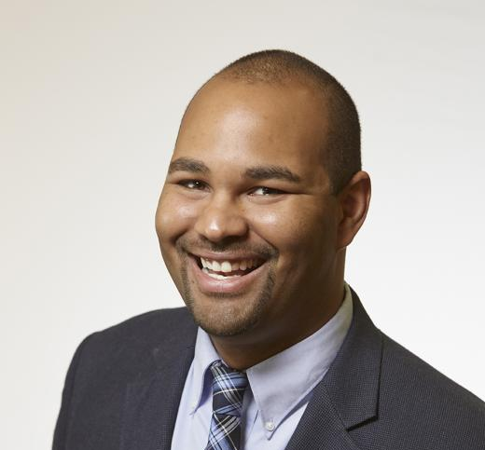
Introduccion
Lyndon Huling, Ed.D
Gerente,
Reclutamiendo de Liderazgo y Servicios de Diversidad
Notes:
Lyndon

Slide 5
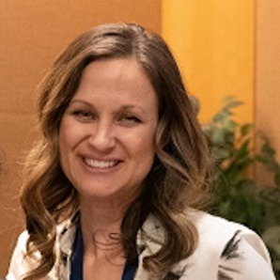
Introduccion
JoAnna Van Brocklin
Analista de Capacitacion, Formacion y Desarollo
Notes:
JoAnna

Slide 6
Pregunta de Encuesta:
Que tipo de posiciones/trabajos te interesan en UC Davis/UC Davis Health?
Notes:
Ellen

Slide 7
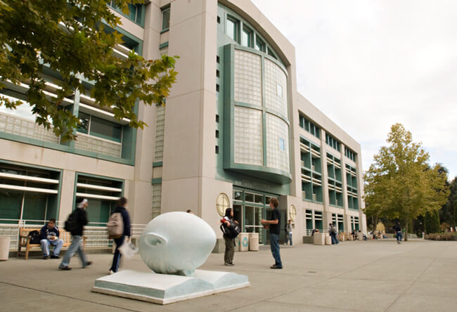
Porque UC Davis?
Notes:
Ellen
-we are a Top 10 Public Research Institution, most comprehensive UC in the system, Vet Med & Ag programs rank among the top in the world
But do you also know that we are
-Top 10 for social mobility
-2nd nationally among Affordable Elite Colleges
- Forbes best based on employee responses

Slide 8
Porque UC Davis Health?
Notes:
Mario
Why UC Davis Health:
Only Level 1 Adult and Pediatric Trauma Center in inland Northern California and the Central Valley
Nationally ranked in multiple specialties
Rated Sacramento’s top hospital
Home of nationally ranked children’s hospital
Top honors for nursing excellence (Magnet recognized)
Patient-centered primary care model
Honored for technology that improves care

Slide 9
Tipos de Posiciones Profesionales en UC Davis
Analista
Cuidado Animal
AdministrativoClerico
Servicios de Entrega
Recaudacion de Fondos/ Desarrollo
Salud Ambiental y de Seguridad
Finanzas
Servicios de Comida
Recursos Humanos
Tecnologia de Informacion
Operaciones y Mantenimiento
Mercadotecnia y Comunicacion
Auxiliar Medico
Enfermeros
Investigacion
Manualidades Calificadas y Comercio
Servicios Estudiantiles
Y mucho mas!
Notes:
Mario

Slide 10
Puestos de Carrera- Nivel de Entrada
Coordinador de Servicios de Oficina Medica
Asistentes Administrativos
Posiciones Custodiales
Posiciones de Servicios de Alimento
Puestos de Asistente de Hospital(Tecnico de quemaduras, miembros del equipo de elevacion, abastecedores, etc.)
Posiciones Laborales

Slide 11
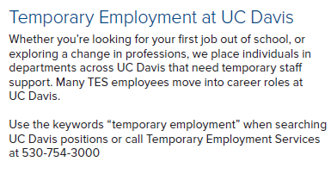
Servicio de Empleo Temporal(TES)
Porque TES?
Salarios Competitivos
Entrenamiento de abilidades en el trabajo
Beneficios Universitarios, incluyendo beneficios medicos
Oportunidades Profesionales dentro de UC Davis y UC Davis Health
Oportunidades de establecer contactos en redes
Oportunidades:
Oportunidades Administrativas y Clericas
Posiciones Analiticas
Posiciones Tecnicas( ayudante de laboratorio, tecnicos en animales)
Posiciones de Computador y Programacion
Notes:
Mario
*Classification of where you are placed is based off of your education and experience
Talk about a handful of colleagues within HR and that started in the temp pool and are now in leadership/management roles.

Slide 12
Puerta de Entrada para el Candidato
hr.ucdavis.edu
Notes:
Mario

Slide 13
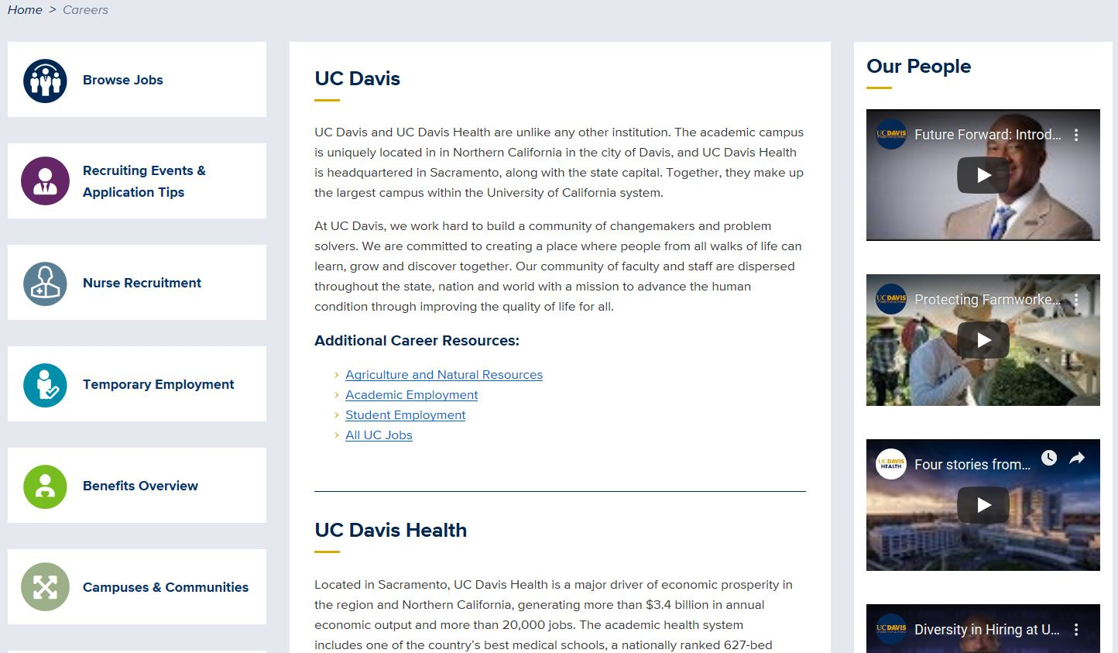
Puerta de Entrada para el Candidato
https://hr.ucdavis.edu/careers
Notes:
Mario

Slide 14
Buscar/ Navegacion de Empleos https://hr.ucdavis.edu/careers
Notes:
Mario
Give attended time to explore using keywords

Slide 15
Solicitud de Empleo
Notes:
Mario

Slide 16
Solicitud de Empleo
https://hr.ucdavis.edu/jobtalk
Searching for Job
How to Apply
Notes:
Mario
These are expandable fields. Step by step on how to search for position and how to apply.

Slide 17
Estatuto/estado de Trabajo
Cuando inicies la sesion en TAM, podras ver tu estado como solicitante. Normalmente el estado se actualiza despues de la fecha de cierre.
Notes:
Mario

Slide 18
La Aplicacion en linea
Su solicitud en línea (separada del currículum) debe contener toda su experiencia que se alinee con las calificaciones mínimas y preferidas.
Notes:
Mario

Slide 19
Cartas de Presentacion
Destaca y resalta tu interes en el Departamento
Porque tu?
Porque ellos?
Porque esta posicion?
Provee Contexto
Brechas en el empleo
Experiencias revelantes o equivalentes
Notes:
Ellen
Share story about new grad having trouble writing cover letter
Do your research about the department: Mission, vision, points of distinction, etc.
How does the vision and mission of the department align with yours
What innovating ideas will you bring to this new position
Professional Growth

Slide 20
Curriculum: Que buscan los reclutaodres de UC Davis?
Tu curriculum es la herramienta mas grande que tienes para comercializate!
Necesita estar actualizado
Como cumples o excedes las calificaciones requeridas (minimas) y/o preferidas?
Anos de experiencia
Habilidades y Logros
Titulos, Certificaiones y Licencias, etc.
**No assumas que sabemos**
Notes:
Ellen
Resume – expand on experience and accomplishments. Application has a limitation on characters per field.
Resume – Can be more than two pages.
Years of relevant experience
Degree/certificate of completion (Bachelors, Master, Certified Medical Assistant, etc.
Licenses/certifications (ACLS, BLS, CPR, etc.)

Slide 21
Reaunudar/escribir tu Curriculum
Notes:
Ellen

Slide 22
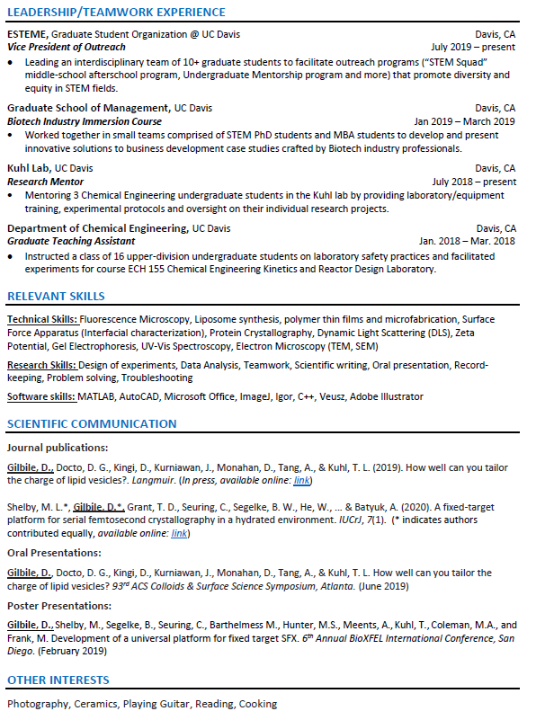
Reanudar/Escribir su Curriculum
Notes:
Ellen

Slide 23
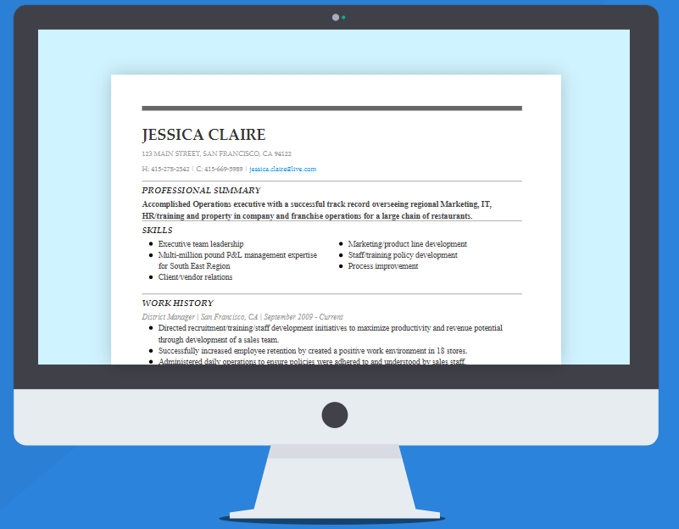
Reanudar/Escribir su Curriculum
Nombre y Apellido
Direccion de casa
Informacion del contacto( numero de celular y correo electronico)
Resumen Profesional
Habilidades
Licencias/Certificaciones (si es requerido por el trabajo)
Historial de Tabajo( Incluya fechas)
Trabajo Voluntario (si las hay)
Publicaciones (si las hay)
Notes:
Ellen
Tailor your resume to the position you are applying to
Professional Summary – Give the hiring manager or person viewing your resume glimpse into your expertise
Skills – Languages, decision making, conflict resolution, creativity, etc
Work History –Bullet points – High light main task of your current position.
Volunteer work – transferable skills (volunteer at a summer camp and now applying to a new grad peds nurse position)
Other – anything else you would like to include – hobbies, activities, etc.

Slide 24
Descripciones de Trabajo y Seleccion
La selección se basa en la descripción del trabajo
La rejilla de detección utilizada por los reclutadores
Solo aquellos que cumplan o excedan las calificaciones requeridas seran enviados al gerente de contratación
Alto numero de solicitantes→ haste destacar!
Calificaciones preferidas
Notes:
Ellen
We literally screen by checking off an excel sheet if applicants meet or do not meet the required and preferred qualifications.
i.e. you might be a Medical Director, but if you don’t confirm that you are a licensed physician in the state of California with your CPR certification (listed as MQ) then I simply cannot assume. Make sure you include the details!

Slide 25
Consejos deLinkedIn y herramientas como candidato
Foto de perfil
Professional, accessible, feliz pero no falso
Titular/ encabezamiento
Con capacidad de busqueda!
Piensa en tu marca
Abierto a nuevas oportunidades?
Hagale saber a los reclutadores!
Acerca de..
Agregue especialidades para insertar palabras claves
Palabras Claves
Experiencia
LinkedIn v. Curriculum
Recomendaciones, abilidades y apoyos
Consigue el respaldo; pide y devuelve el favor
Notes:
Ellen
Profile photo – look happy, approachable, professional…but not fake! Nice headshot
Headline – use this to your advantage – put in those keywords, key points you want associated with your brand! You’re usually searched through headlines and keywords over company name
Open to new opps – first people I will look at when I run a search
About – tell your story in a few lines using keywords and quantify your accomplishments; i.e. hired 2000 professionals into executive level roles, managed staff of up to 60 → this is an area recruiters will see and read first, stand out! Add in “specialties” where you can put in keywords – we like white space
Keywords – use the keywords that you want recruiters/HMs to find you with; great place is in the about section and in your work history
**if there’s someone that has a job you love, look at their profile for ideas
**if you see keywords or repetitive phrases in the job description, use them on your profile
Experience – work history, job title, bullet points → quantify the keywords you’ve used above, validate your experience
**Your bullet points should be similar on both your resume and LinkedIn page. If I look at your resume and LI profile, I should know I’m looking at the same person
**They don’t have to be identical though as you should always be tailoring your resume, cover letter and application to each position that you apply to
Skills & Endorsements – get endorsed! Ask (appropriate current/past colleagues) and offer to return; especially helpful to get endorsed for skills that speak to industry knowledge
Recommendations – same as endorsements, but this is like a mini reference check

Slide 26
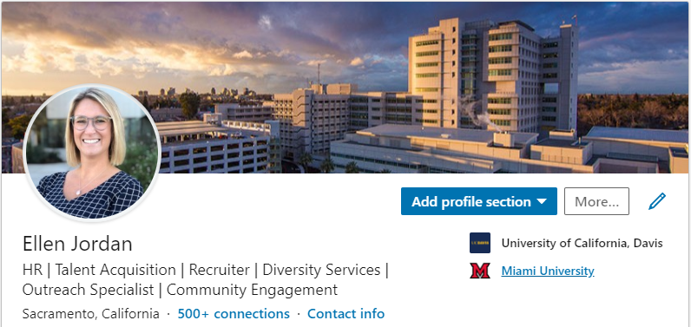
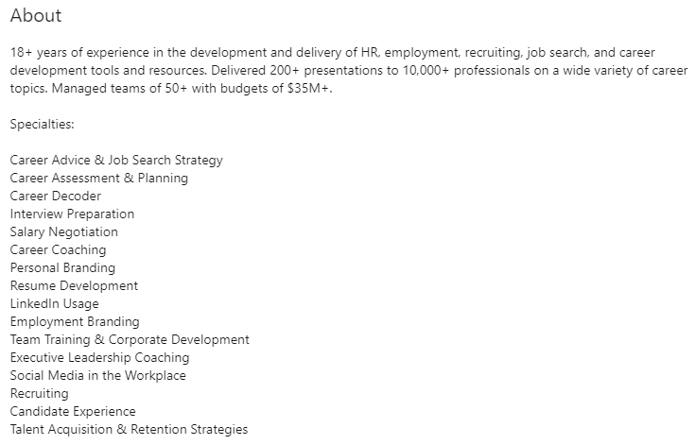
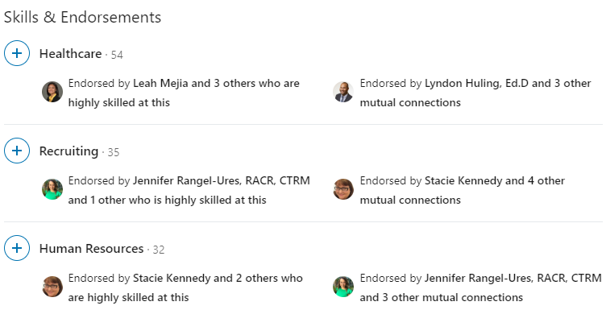
Quick snapshot of experience
Using “Specialties” to insert keywords associated with you/the job you’re looking for
Friendly face & keywords/branding regarding my experience, NOT my job title and employer
Demonstrates that others endorse you for the skills you say you have
Notes:
Ellen
I need to do a run through on timing, I may not include this slide.
Use the about section to create white space; I don’t want to read three paragraphs to find if you have X, Y, Z skills

Slide 27
Diversidad, Equidad e Inclusión
Notes:
Lyndon
ERG Awards
Recognized as

Slide 28
Diversidad, Equidad e Inclusión
Notes:
Lyndon

Slide 29
Diversidad, Equidad e Inclusión
Notes:
Lyndon

Slide 30
Apoyo para tu crecimiento personal y profesional
https://hr.ucdavis.edu/departments/learning-dev
Notes:
UCD does not simply want you to apply for a “job” – we want you to fulfill your career!
Learning and Development team supports our most important asset – YOU (employees)!
We want you to feel empowered to take control of your personal and professional growth.
PD time = 40 hrs/yr for represented EEs; 80 hrs/yr for non-rep EEs.
1.Tuition Assistance: tuition discounts, scholarships, and for UCDH tuition reimbursement
2.Development Programs: Entry level to leadership programs. AAA, LC, MSAP, GMP, AOFTF
3.Career Management: Career Counseling, toolkits, cross training, training (certificate programs, eLearnings and ILTs such as MS courses – ppt, excel).

Slide 31
Recursos Adicionales
EMPLOYEE RESOURCE GROUPS
Staff
Assembly
Chancellor’s Committee on Lesbian, Gay, Bisexual, Transgender, Queer, Intersex, and Asexual Issues
Latinx Staff & Faculty Association
(LSFA)
Asian Pacific American Systemwide Alliance
(APASA)
African American Faculty & Staff Association
(AAFSA )
DIVERSE
Abilities
Veteran Constituency Group
Status of Women at Davis Administrative Advisory Committee
(SWADAAC)
PRIDE – LGBTQ+ Employee Resource Group
Native American Faculty and Staff Association (NAFSA)
Disabilities Issues Administrative Advisory Committee (DIACC)
Veteran Employee Association
Administrative Management Group (ADMAN)
Grupo de Recursos para Empleados
Vida Laboral
Descuento/rebate
https://hr.ucdavis.edu/employees
Notes:
1. [CLICK] Employee Resource Groups: not only to make connections with areas of interest and community outreach opportunities; excellent way to build skills toward personal and professional goals.
2. [CLICK] WorkLife: promote and honor your commitments to both family and career. Programs support dependent care as well as adult/elder care; WorkLife transitions through breastfeeding support program and retirement workshops; health & wellness programs/events.
3. [CLICK] Discounts: entertainment and travel discounts, educational discount partners.

Slide 32
Gracias…
Preguntas?!
Notes:
Lyndon

Slide 33
Informacion de los contactos:
Ellen Jordan – ekjordan@ucdavis.edu
Mario Eguizabal – meeguizabal@ucdavis.edu
Lyndon Huling – lahuling@ucdavis.edu
JoAnna Van Brocklin – jvanbrocklin@ucdavis.edu
Notes:
Lyndon
Content on website

